Slide 1
The Future of Automation and Artificial Intelligence
Impact on highly skilled professions.

Slide 2
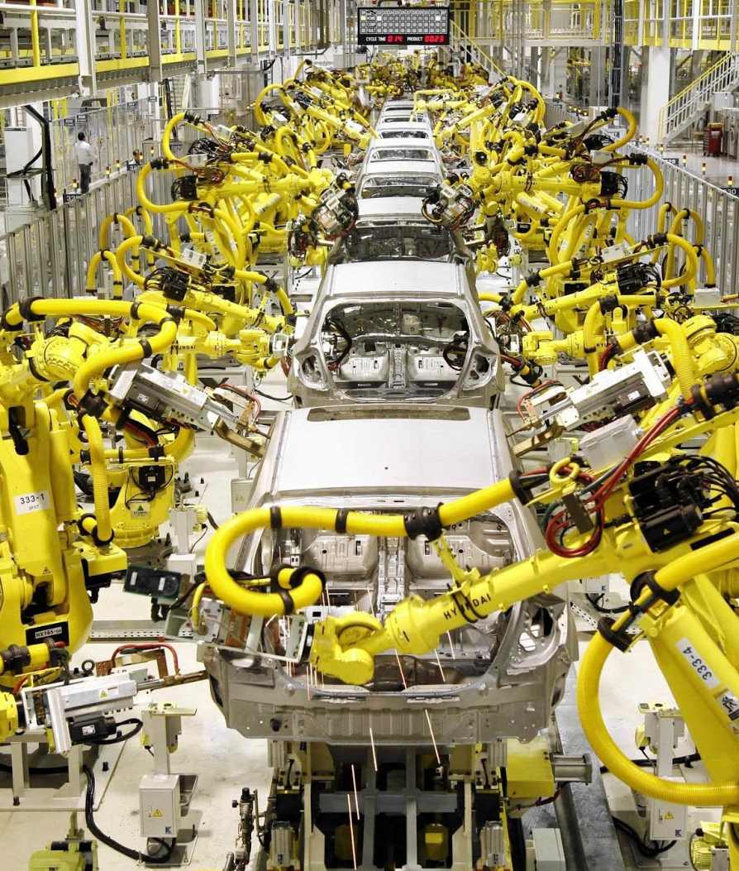
Background
“Dumb” automation has been effecting US workers for decades.
This results in replacing many low skill workers with few high skill workers.
Parallels to every major technical advance in the past. This is neither new nor overly concerning.
Notes:
dumb automation for decades
many low skill -> few high skill
parallels to old tech advance, just provides new methods of employment
that said, still causing lots of unemployment (not everyone can be a high skilled worker

Slide 3
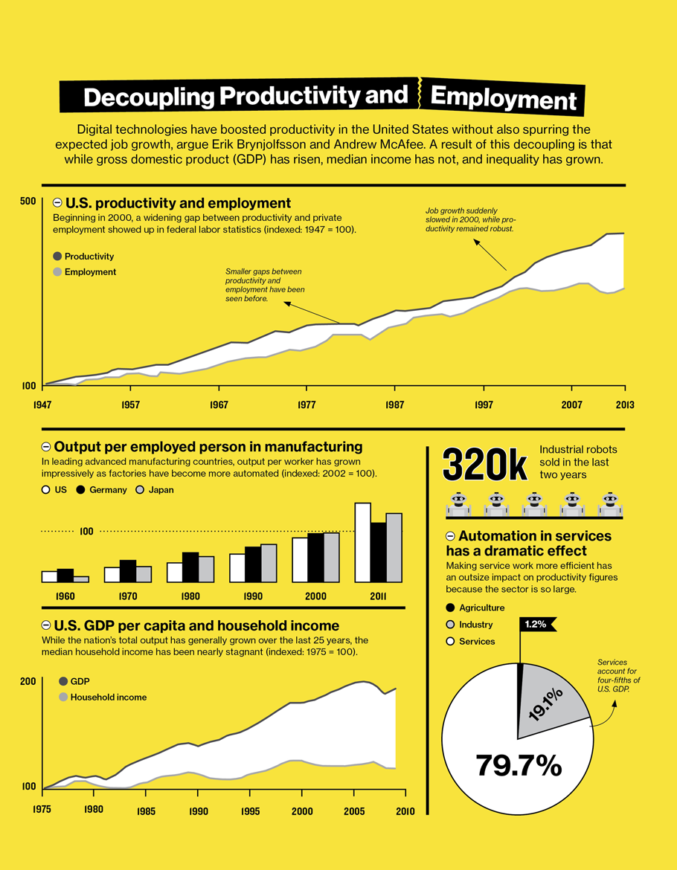
Some numbers.
Between 2000 and 2010, the United States lost approximately 5.6 million manufacturing jobs. 85% of those were to automation.
A welder being paid $25/hour can be replaced by a machine that costs only $8/hour to operate.
https://www.technologyreview.com/s/515926/how-technology-is-destroying-jobs/
Notes:
2000 to 2010 - 5.6m jobs lost (85% to automation)
welder $25/hour - > machine $8/hour

Slide 4
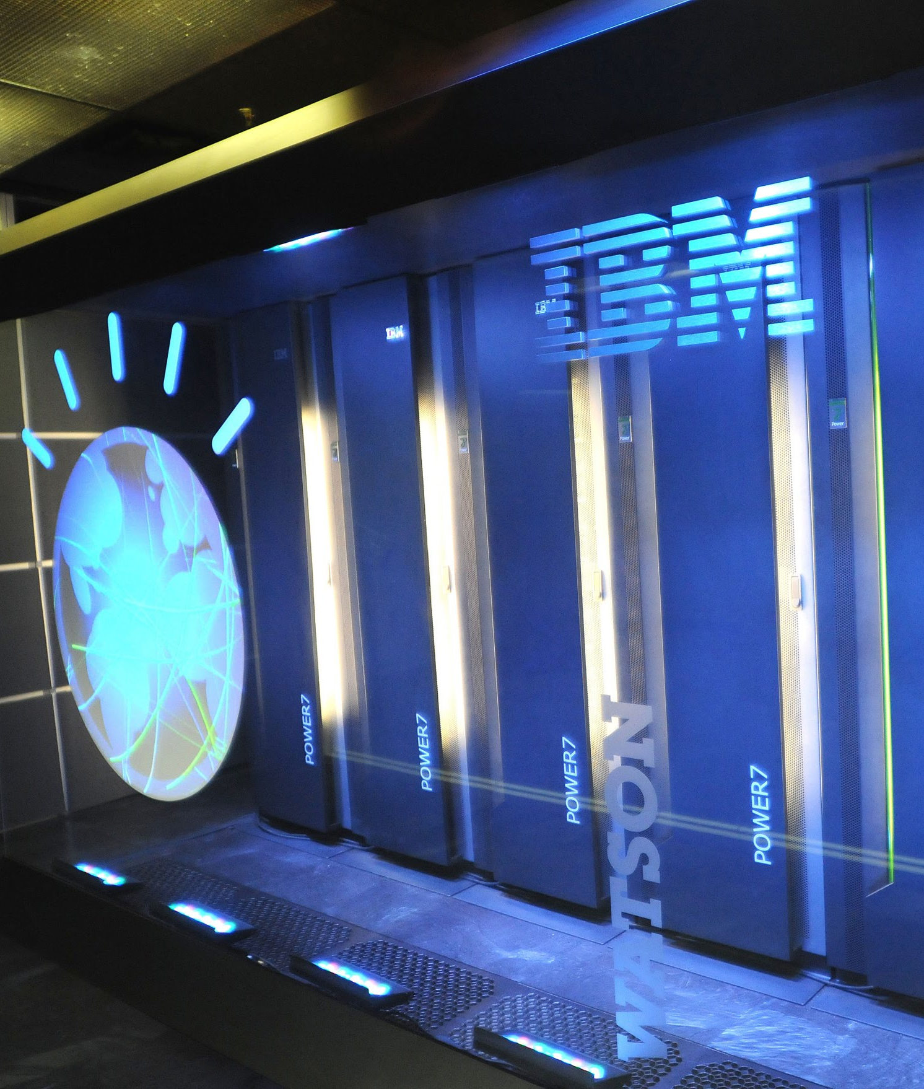
Near Future
Discovery in legal cases is currently being assisted by artificial intelligence.
IBM’s Watson is better at diagnosing cancer than human Oncologists.
Data entry/analysis jobs are highly at risk of automation.
Notes:
AI assisted legal discovery
watson > oncologists for cancer diagnosis
data entry/analysis vulnerable

Slide 5
Some more numbers.
1,076,000 people are employed in the legal profession.
8,318,500 people in healthcare.
22,026,000 people in office and administrative support.
9,732,000 people in Transportation (Human and commercial)
> 41,152,500 people highly at risk of losing their jobs to automation.
Soon.
Notes:
legal - 1m
healthcare - 8.3m
office/admin - 22m
transportation - 9.7m
sum of above - 41.1m

Slide 6
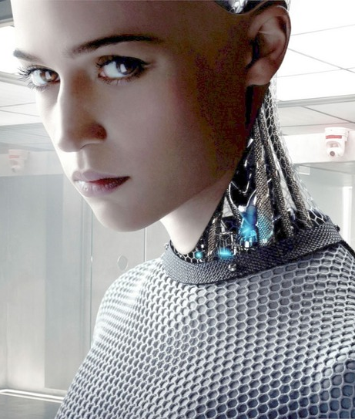
What’s to come?
The largest obstacle to a general artificial intelligence is the fact that we don’t actually know what “intelligence” is.
The second largest is computational power.
Notes:
This should be an easy min of talking

Slide 7
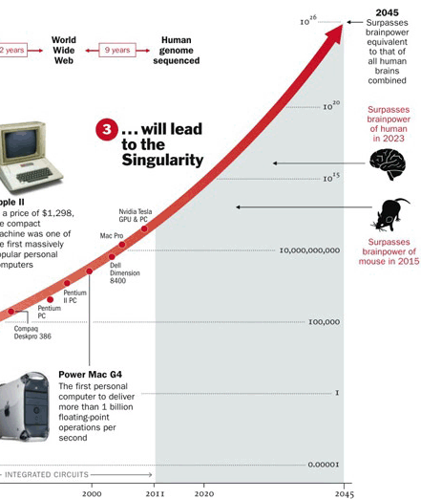
Moore’s Law
Exponential increases in computing power means that the raw power available to an intelligent machine will vastly outmeasure that of a human.
Eventually, it will vastly outmeasure all humans.

Slide 8
“Intelligence”
Intelligence always seems to be one step away.
Before there was an AI that could beat humans in chess, a chess-playing AI was “intelligent”
Before there was an AI that could beat humans in go, a go-playing AI was “intelligent”
There needs to be an established definition of intelligence before we can claim to have an intelligent computer
That said…

Slide 9
…Is not necessary.
The inflection point for mass automation is not a general artificial intelligence.
It is simply a program that can do 2 things:
Improve itself
Create (arbitrary) other programs.

Slide 10
References
https://www.ft.com/content/dec677c0-b7e6-11e6-ba85-95d1533d9a62
https://www.technologyreview.com/s/515926/how-technology-is-destroying-jobs/
http://www.nytimes.com/2011/03/05/science/05legal.html
http://www.wired.co.uk/article/ibm-watson-medical-doctor
http://www.mckinsey.com/business-functions/digital-mckinsey/our-insights/where-machines-could-replace-humans-and-where-they-cant-yet
https://www.bls.gov/emp/ep_table_102.htm
Notes:
0 min talking

Slide 11
Questions?

